Slide 1
Minimum Coin Change using dynamic programming
Ahmed Hussein Mohamed
210883

Slide 2

Agenda
The problem
The strategy
The algorithm
The implementation
The analysis (Time complexity)

Slide 3
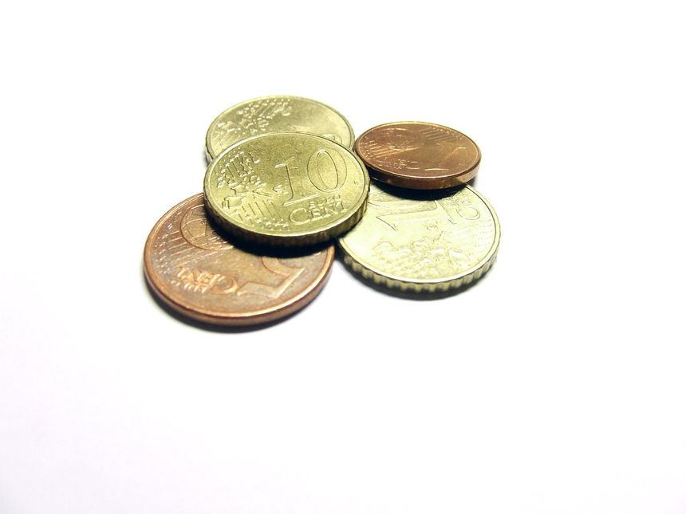
The problem
Coin Change
Finding the minimum number of ways to make a specific amount of money (Target) using a given set of coin denominations.
Target = 11, coin_denominations [1, 5, 6, 8].

Slide 4
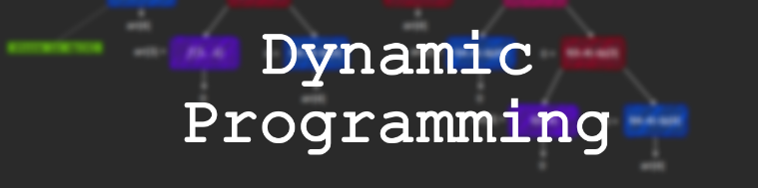
The strategy
Breaking down the complex problem into smaller “Subproblems”, then solve each subproblem once and finally record solutions in a table.

Slide 5
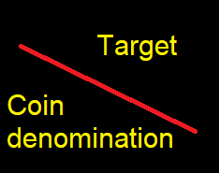
How does the algorithm work!
How many minimum ways needed to get these targets?
Min( )
 | 0 | 1 | 2 | 3 | 4 | 5 | 6 | 7 | 8 | 9 | 10 | 11
1
5
6
8

Slide 6
How does the algorithm work!
How many minimum ways needed to get these targets?
Min( )
 | 0 | 1 | 2 | 3 | 4 | 5 | 6 | 7 | 8 | 9 | 10 | 11
1 | 0
5 | 0
6 | 0
8 | 0

Slide 7
How does the algorithm work!
How many minimum ways needed to get these targets?
Min( )
 | 0 | 1 | 2 | 3 | 4 | 5 | 6 | 7 | 8 | 9 | 10 | 11
1 | 0 | 1 | 2 | 3 | 4 | 5 | 6 | 7 | 8 | 9 | 10 | 11
5 | 0
6 | 0
8 | 0

Slide 8
How does the algorithm work!
How many minimum ways needed to get these targets?
Min( )
 | 0 | 1 | 2 | 3 | 4 | 5 | 6 | 7 | 8 | 9 | 10 | 11
1 | 0 | 1 | 2 | 3 | 4 | 5 | 6 | 7 | 8 | 9 | 10 | 11
5 | 0 | 1 | 2 | 3 | 4 | 1 | 2 | 3 | 4 | 5 | 2 | 3
6 | 0
8 | 0

Slide 9
How does the algorithm work!
How many minimum ways needed to get these targets?
Min( )
 | 0 | 1 | 2 | 3 | 4 | 5 | 6 | 7 | 8 | 9 | 10 | 11
1 | 0 | 1 | 2 | 3 | 4 | 5 | 6 | 7 | 8 | 9 | 10 | 11
5 | 0 | 1 | 2 | 3 | 4 | 1 | 2 | 3 | 4 | 5 | 2 | 3
6 | 0 | 1 | 2 | 3 | 4 | 1 | 1 | 2 | 3 | 4 | 2 | 2
8

Slide 10
How does the algorithm work!
How many minimum ways needed to get these targets?
Min( )
 | 0 | 1 | 2 | 3 | 4 | 5 | 6 | 7 | 8 | 9 | 10 | 11
1 | 0 | 1 | 2 | 3 | 4 | 5 | 6 | 7 | 8 | 9 | 10 | 11
5 | 0 | 1 | 2 | 3 | 4 | 1 | 2 | 3 | 4 | 5 | 2 | 3
6 | 0 | 1 | 2 | 3 | 4 | 1 | 1 | 2 | 3 | 4 | 2 | 2
8 | 0 | 1 | 2 | 3 | 4 | 1 | 1 | 2 | 1 | 2 | 2 | 2
5+6

Slide 11
How does the algorithm work!
How many minimum ways needed to get these targets?
Min( )
 | 0 | 1 | 2 | 3 | 4 | 5 | 6 | 7 | 8 | 9 | 10 | 11
1 | 0 | 1 | 2 | 3 | 4 | 5 | 6 | 7 | 8 | 9 | 10 | 11
5 | 0 | 1 | 2 | 3 | 4 | 1 | 2 | 3 | 4 | 5 | 2 | 3
6 | 0 | 1 | 2 | 3 | 4 | 1 | 1 | 2 | 3 | 4 | 2 | 2
8 | 0 | 1 | 2 | 3 | 4 | 1 | 1 | 2 | 1 | 2 | 2 | 2
5+6

Slide 12
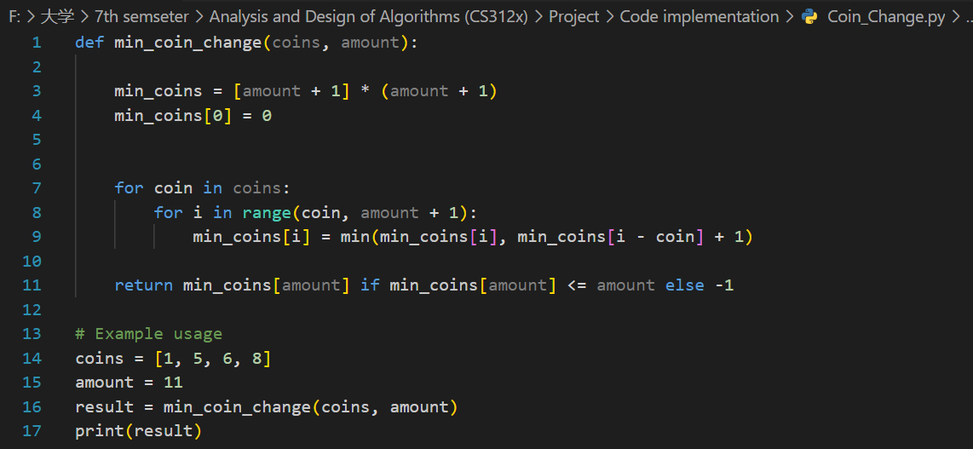
The Implementation

Slide 13
Time complexity
1

Slide 14

Time complexity
Assume that (amount +1) is m
$$\sum_{i=coin}^{m}{\left(1\right)}$$

Slide 15

Time complexity
j=1
Assume that (coins) is n
$$\sum_{j=1}^{n}{}$$
$$\sum_{i=coin}^{m}{\left(1\right)}$$

Slide 16
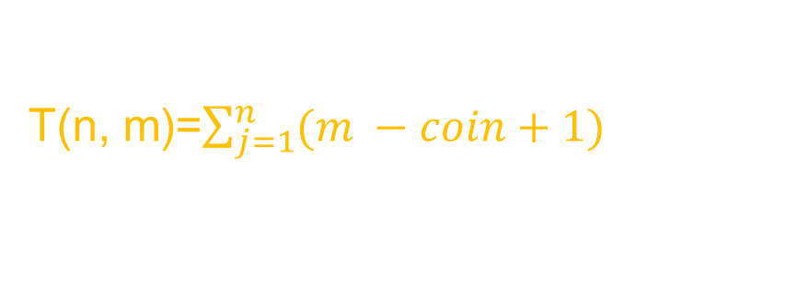
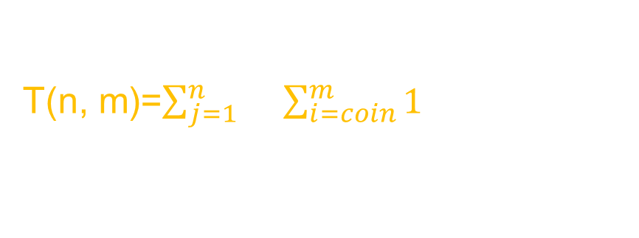
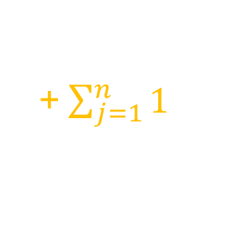
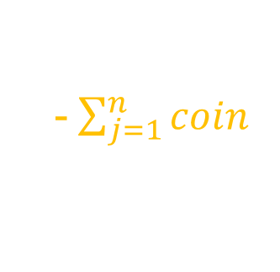
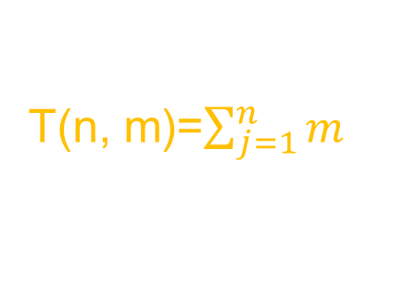
Time complexity
T(n, m)=$\sum_{j=1}^{n}{}\sum_{i=coin}^{m}{1}$
T(n, m)=$\sum_{j=1}^{n}{(m −coin+1})$
T(n, m)=$\sum_{j=1}^{n}{m}$
-$\sum_{j=1}^{n}{coin}$
+$\sum_{j=1}^{n}{1}$
n . m
- S
+ n
O(n.m) = O(nm)

